Slide 1
Verb Tense Review
Mrs. Alba
ESL Level 4
National City Adult School

Slide 2
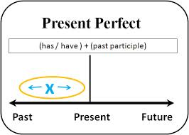
Present Perfect Tense

Slide 3
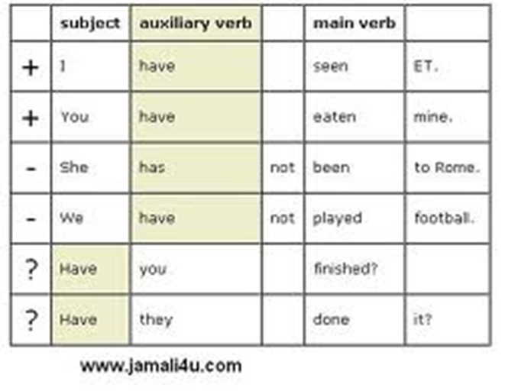
Present Perfect Tense: Use “have” or “has”

Slide 4
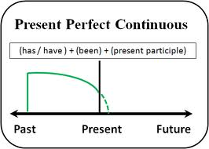
Present Perfect Continuous Tense

Slide 5
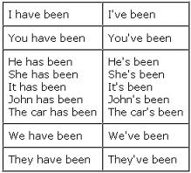
Present Perfect Continuous Tense
Wor
Working.

Slide 6
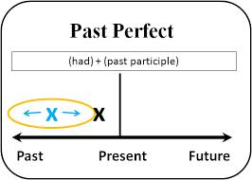
Past Perfect Tense

Slide 7
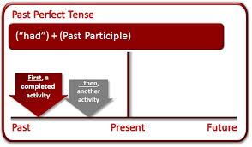
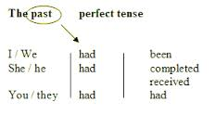
Past Perfect Tense: using “had”

Slide 8
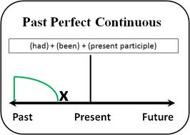
Past Perfect Continuous Tense

Slide 9
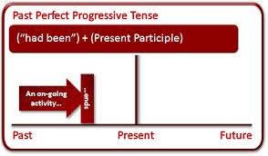
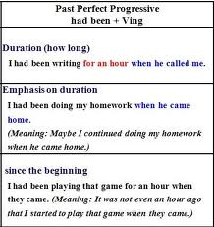
Past Perfect Continuous Tense

Slide 10
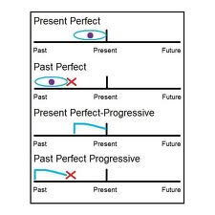
Review of Perfect & Continuous Tenses

Slide 11
Any Questions???

