Slide 1
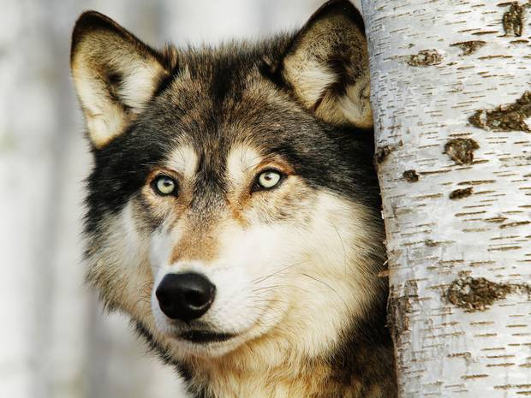
MY FAVORITE ZOO ANIMALS MIGUEL ANGEL ESL 2 08/19/15 MIGUEL ANGEL

Slide 2
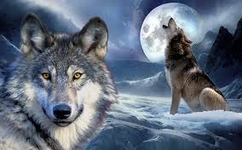
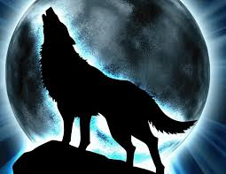
THE WOLF IS AGGRESSIVE

Slide 3
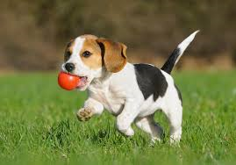
THE DOG IS SMART

Slide 4
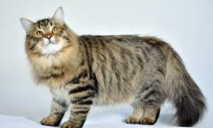
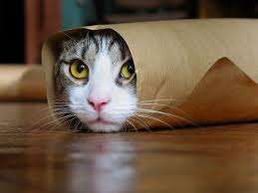
THE CAT ARE PLAYFUL

Slide 5
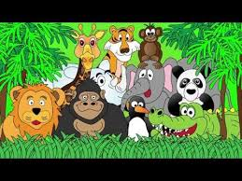
THANK YOU

