Slide 1
BBC learning English: Words in the news
Mrs. Alba
ESL

Slide 2
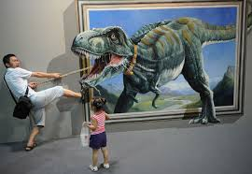
TITLE: 3D Paintings

Slide 3
#1) encourages
supports cutting into small pieces

Slide 4
#5) exhibits
items shown in a museum or art gallery air that comes out of your mouth

Slide 5
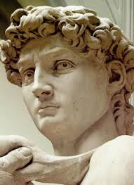
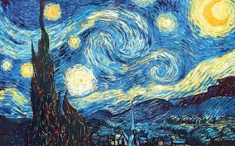
#3) artwork
a piece of art. (Example: painting, sculpture) ew plant produced from two different types of plant

Slide 6
#2) optical illusions
visual deception types of something

Slide 7
#4) brainchild
creative idea smell from food or drink

Slide 8
BBC LEARNING ENGLISH WORDS IN THE NEWS
watch the news video
http://www.bbc.co.uk/learningenglish/english/features/witn/ep-150408

