Slide 1
BBC learning English: Words in the news
Mrs. Alba
ESL

Slide 2
TITLE: Flying FOOd

Slide 3
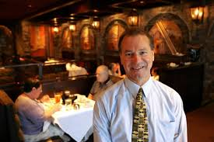
#1) restaurateurs
people who own or run restaurantscutting into small pieces

Slide 4
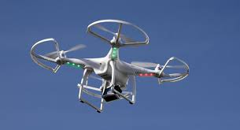
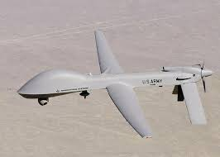
#2) drones
unmanned flying machines; they are remotely controlled
https://www.youtube.com/watch?v=HopKAYthJV4 ifferent types of something

Slide 5
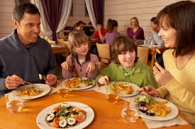
#3) diners
people who eat in a restaurant
ew plant produced from two different types of plant

Slide 6
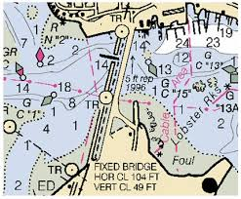
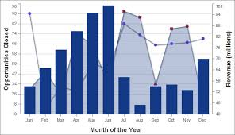
#4) charted
nplanned or mapped outce smell from food or drink

Slide 7
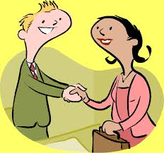
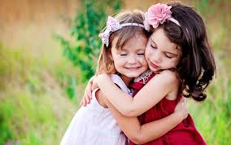
#5) the human touch
being friendly and warm to other peoplethe air that comes out of your mouth

Slide 8
BBC LEARNING ENGLISH WORDS IN THE NEWS
watch the news video
CLICK below to watch the video:
http://www.bbc.co.uk/learningenglish/english/features/witn/ep-150211

