Slide 1
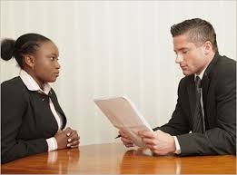
News Story: “Job Interviews”
Mrs. Alba
ESL

Slide 2
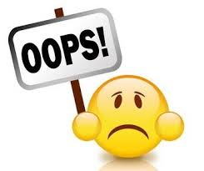
Pitfalls
possible problems that can be anticipated

Slide 3
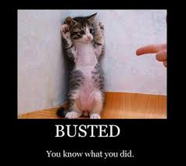
caught out
discovered doing something wrong

Slide 4
Character traits
elements of your personality

Slide 5
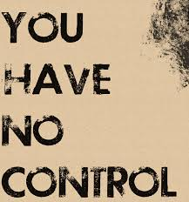
Anarchic
without rules, order, or control

Slide 6
Superficial
simple, not very detailed

Slide 7
Wily
smart, intelligent

Slide 8
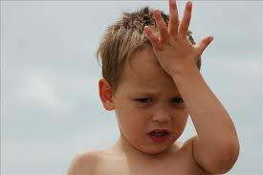
To see through the veneer (expression)
to realize easily that your knowledge is not very detailed

Slide 9
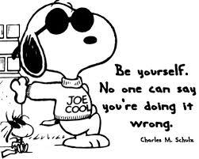
mannerism
someone's individual way of speaking or moving

Slide 10
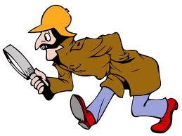
Scrutinized
examined on close detail

Slide 11
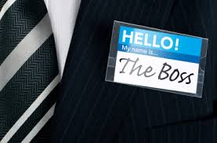
Entrepreneur
someone who starts their own businesses

Slide 12
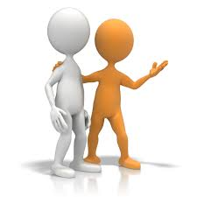
Mentor
someone who gives advice, support and encouragement; a role-model

Slide 13
Workforce
all the people who work for a company

Slide 14
BBC News Story: Job Interviews
Let’s listen to the story: Job Interviews
http://www.bbc.co.uk/learningenglish/english/course/lower-intermediate/unit-27/session-4/activity-3

