Slide 1
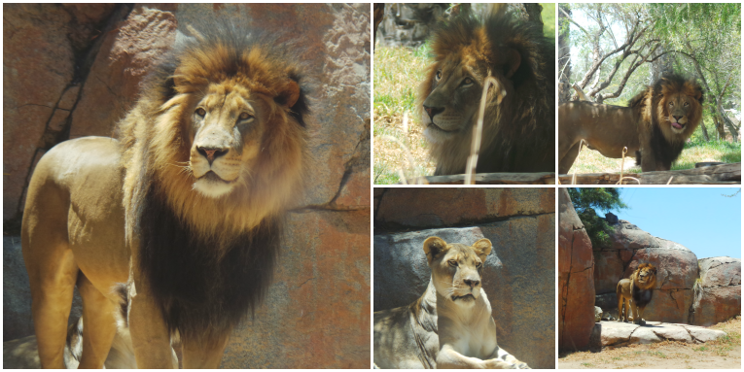
My favoryte zoo animal
Arturo calderon
Esl2
08 19 15

Slide 2
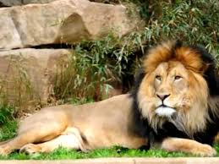
I like the lions

Slide 3
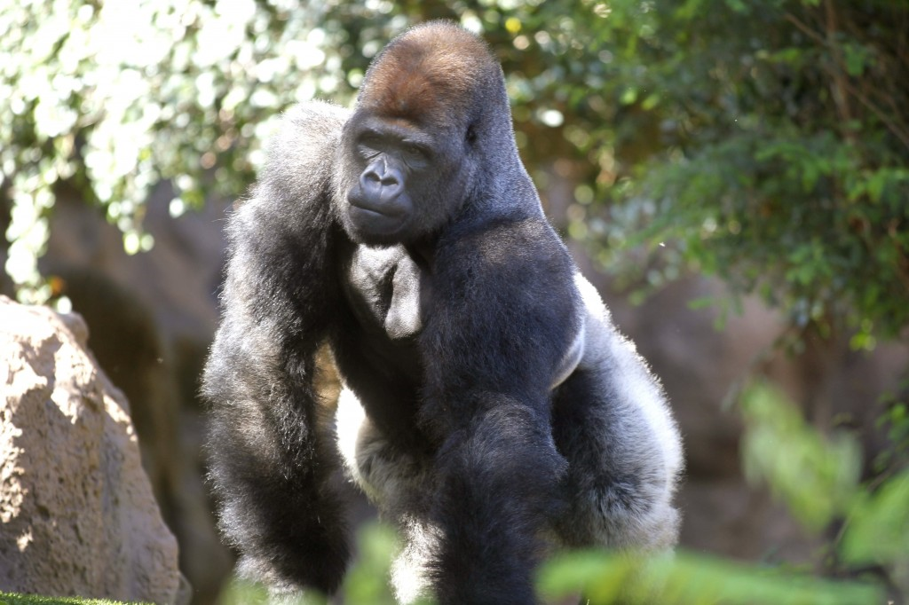
I like to see the gorillas

Slide 4
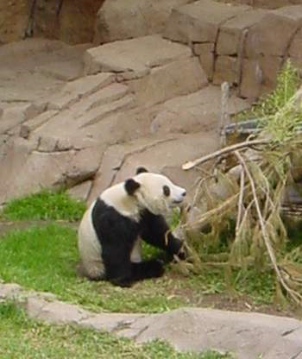
The panda has beautiful colors

Slide 5
THANK YOU

