Slide 1
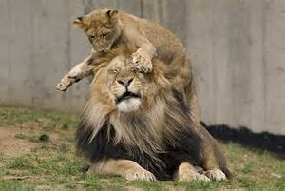
The king of the jungle
ALFREDO CASTILLO 08/19/15
ESL 2

Slide 2
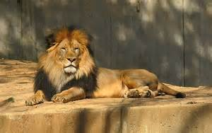
HE LOOKS POWERFUL

Slide 3
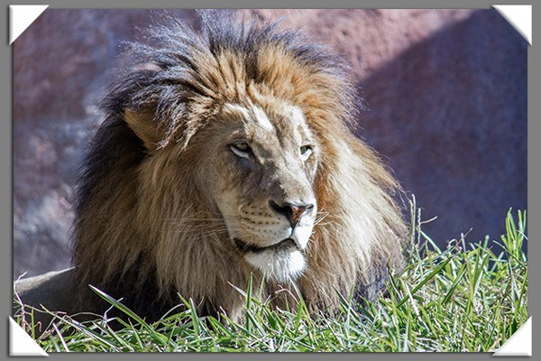
HE IS RELAX

Slide 4
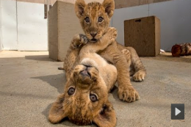
THEY’RE CUTE

Slide 5
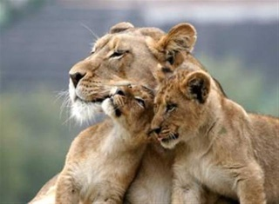
THEY PROTECT THEIR FAMILY

