Slide 1
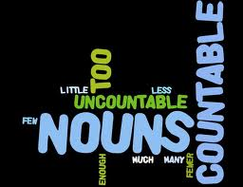
Count & Non-Count NOUNS
ESL 2
Mrs. Alba

Slide 2
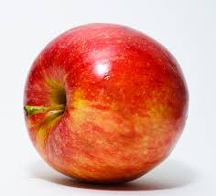
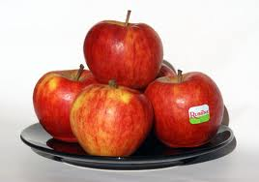
Count Nouns
RULE: There are two groups of nouns called Count and Non-Count
COUNT Nouns: are nouns you can count. Count nouns have a singular and a plural form.
EXAMPLE:
I have an apple. (singular)
She has four apples. (plural)

Slide 3
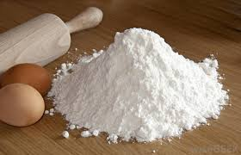
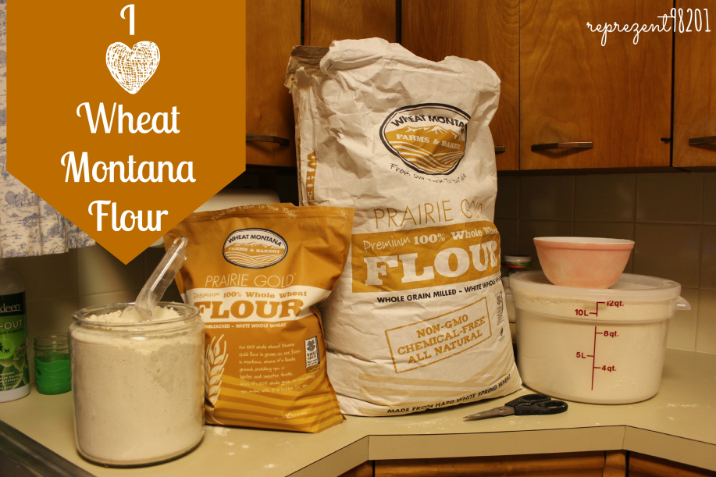
Non-Count Nouns
RULE: Non-Count nouns are nouns you cannot count. Non-count nouns have only one (singular) form.
EXAMPLES:
Where’s the flour?
The flour is on the counter?

Slide 4
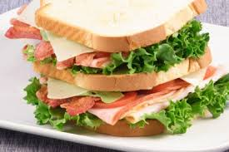
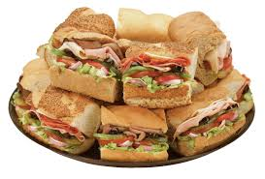
Sandwhich
Count noun

Slide 5
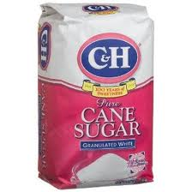
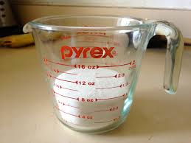
Sugar
Non-count noun
Bag of sugar
Cup of sugar

Slide 6
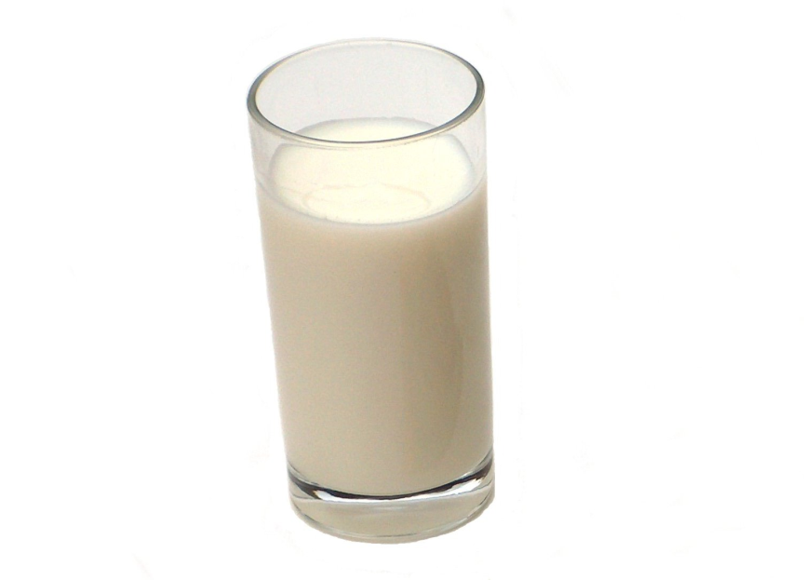
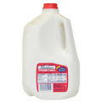
Milk
Non-count noun
Glass/gallon of milk

Slide 7
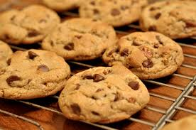
Cookies
Count noun

Slide 8
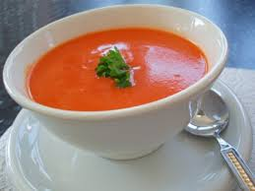
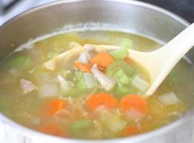
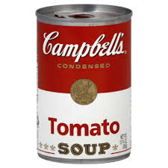
Soup
Non-count noun
Bowl of soup
Can of soup

Slide 9
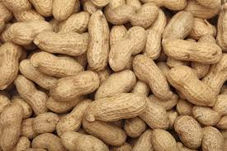
Peanuts
Count noun

Slide 10
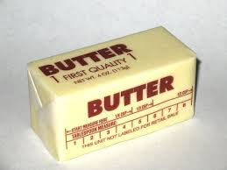
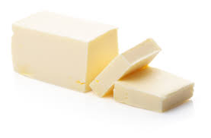
Butter
Non-count noun
Stick of butter
Pat of butter

Slide 11
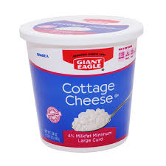
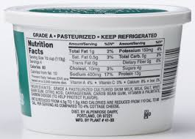
Cottage cheese
Non-count noun
A container of cottage cheese
A serving of cottage cheese

Slide 12
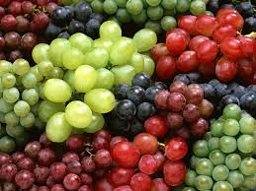
Grapes
Count noun

Slide 13
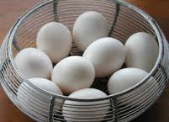
Eggs
Count noun

Slide 14
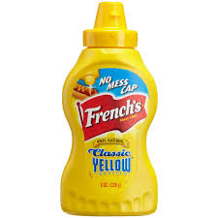
Mustard
Non-count noun
A bottle of mustard

Slide 15
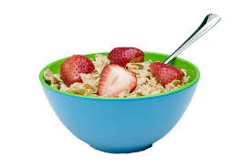
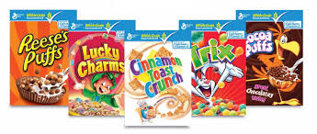
Cereal
Non-count noun
A bowl of cereal
Boxes of cereal

Slide 16
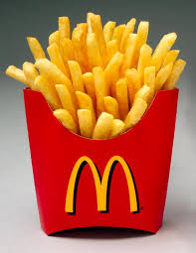
French fries
Count noun

Slide 17
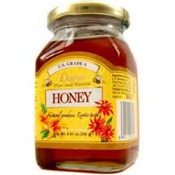
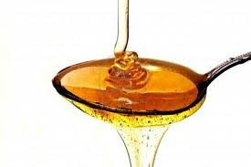
Honey
Non-count noun
A jar of honey
A spoon of honey

Slide 18
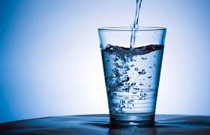
Water
Non-count noun
Glass of water

Slide 19
FOOD Confessions
I always (eat/drink) too (much/many) ______________.
My doctor says I must (eat/drink)
(less/fewer) ______ and more ______.

