Slide 1
My favorite zoo animals
Miss Maria Cuellar ( Sol )
ESL 2
August 19th, 2015

Slide 2
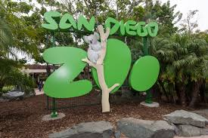
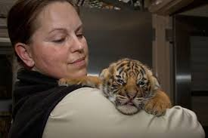
LIFE AT ZOO

Slide 3
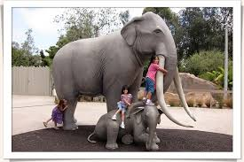
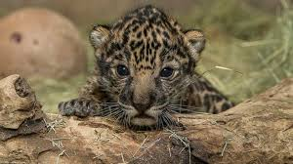
LIFE AMAZING WITH KIDS

Slide 4
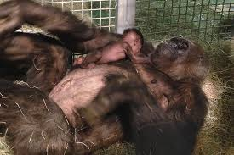
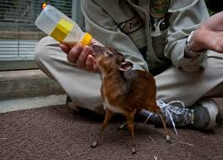
SAVE LIFES

Slide 6
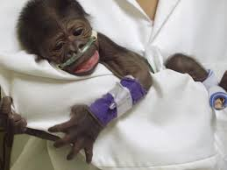
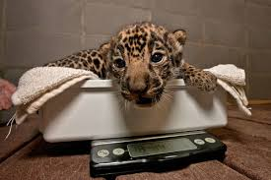
I LIKE THE ANIMALS
THE LIFE IS BEAUTIFUL
AMAZING
Notes:
I SEE THE HAND AND THE POWER OF GOD IN THE LIFE OF EVERY HUMAN AND ANIMAL CREATION OF GOD.

Slide 7
I SEE THE HAND AND THE POWER OF GOD IN THE LIFE OF EVERY HUMAN AND ANIMAL CREATION OF GOD.

