Slide 1
Direct and Indirect Object PRONOUNS
Mrs. Alba
ESL 2
Unit 1

Slide 2
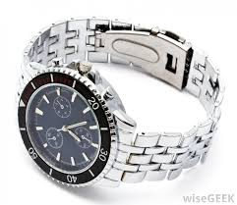
Direct and Indirect Object PRONOUNS
RULE: Direct and indirect object pronouns follow the verb. The direct and indirect object pronouns for he and she are him and her.
EXAMPLES:
What are you going to give your husband for his birthday?
I don’t know. I can’t give him a watch.
What are you going to give your sister for her birthday?
I don’t know. I can’t give her flowers.

Slide 3
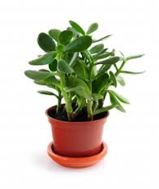
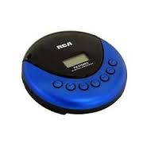
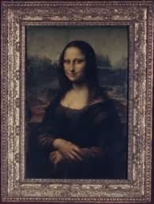
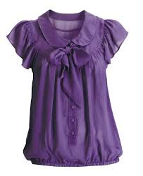
Direct and Indirect Object PRONOUNS
RULE: Direct and Indirect object pronouns follow the verb. The direct and indirect object pronouns for I, you, we and they are me, you, us, and them.
EXAMPLES:
They gave me a CD player.
They gave us a plant.
I gave you a blouse.
I gave them a painting.

