Slide 1
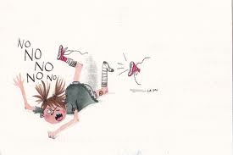
PHRASE: Don’t make a scene
Mrs. Alba ESL 4

Slide 2
Don’t make a scene
DEFINITION: to be loud and rude with other people or in public.

Slide 3
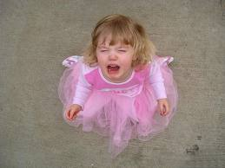
Don’t make a scene
SENTENCES:
My daughter made a scene when I wouldn’t buy her a new toy.
When John found a mistake in our report, he started to make a scene. He threw our report everywhere.

Slide 4
Don’t make a scene
The English we Speak, from BBC Learning English
http://www.bbc.co.uk/worldservice/learningenglish/language/theenglishwespeak/2013/09/130903_tews_139_dont_make_a_scene.shtml

