Slide 1
Emphatic Statements
Mrs. Alba
ESL 4

Slide 2
Emphatic Statements
RULE: Emphasis can be added to a statement by stressing the auxiliary verb. If no auxiliary verb is present in the sentence, do, does, or did is used before the verb as appropriate.

Slide 3
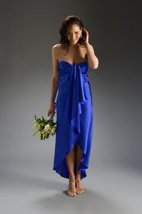
Emphatic Statements
EXAMPLES:
The color blue looks good on you.
The color blue DOES look good on me.
Janet came to class late.
Janet DID come to class late.

Slide 4
Emphatic Statements
RULE: Tags do no always function as questions. They also can be used to confirm a statement. Even though in most grammar books they are called tag questions and are punctuated with a question mark (?), we have chosen to call them tag statements and punctuate them with an exclamation point (!). The rationale for labeling and punctuating them differently is that their intonation (emphasis of pronunciation) differs from tag question intonation.

Slide 5
Emphatic Statements
EXAMPLES:
Aunt Betty hasn’t called in a long time, has she!
I’m playing this song too slowly, aren’t I!

Slide 6
Emphatic Statements
PRONUNCIATION RULE: Tag questions have a rising intonation. Tag statements have a falling intonation.
EXAMPLES:
This is the bus to the zoo, isn’t it?
The color blue looks very good on me, doesn’t it!

