Slide 1
They Really Can’t decide using“might”
UNIT 4….ESL 2
Mrs. Alba

Slide 2
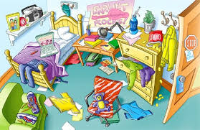
Future Tense: might
RULE: The modal might is used to describe possibility in the present and future.
EXAMPLES:
When are you going to clean your room?
I don’t know. I might clean it today, or I might clean it next Saturday.

Slide 3
Future Tense: might
RULE: The modal might is an auxiliary verb that comines with the base form of the verb. It doesn’t contract with subject pronouns.
EXAMPLES:
I might arrive.
He/She/It might arrive.
We might arrive
You might arrive.
They might arrive.

Slide 4
Any questions?
Let’s go to page 33 of your book.

