Slide 1
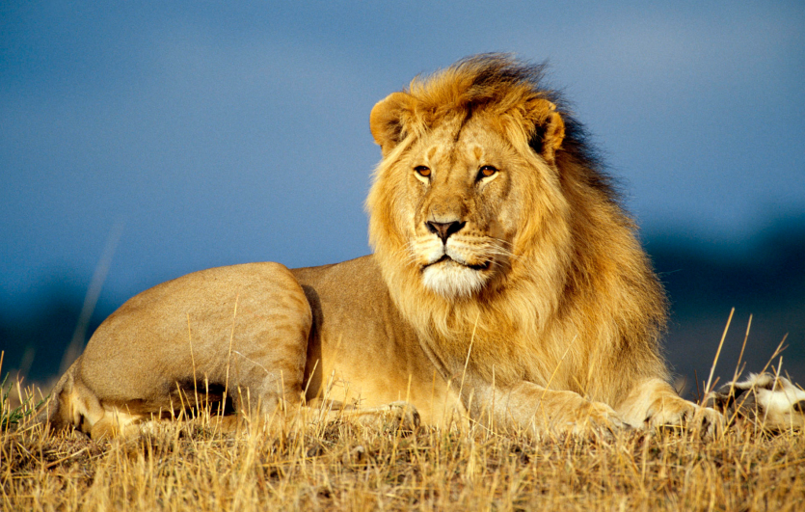
My favorite zoo animals
Is lion
Ana Maria Gomez
Class;ESL 2
Date 8/19/15

Slide 2
I like to see the powerful and interesting lions

Slide 3
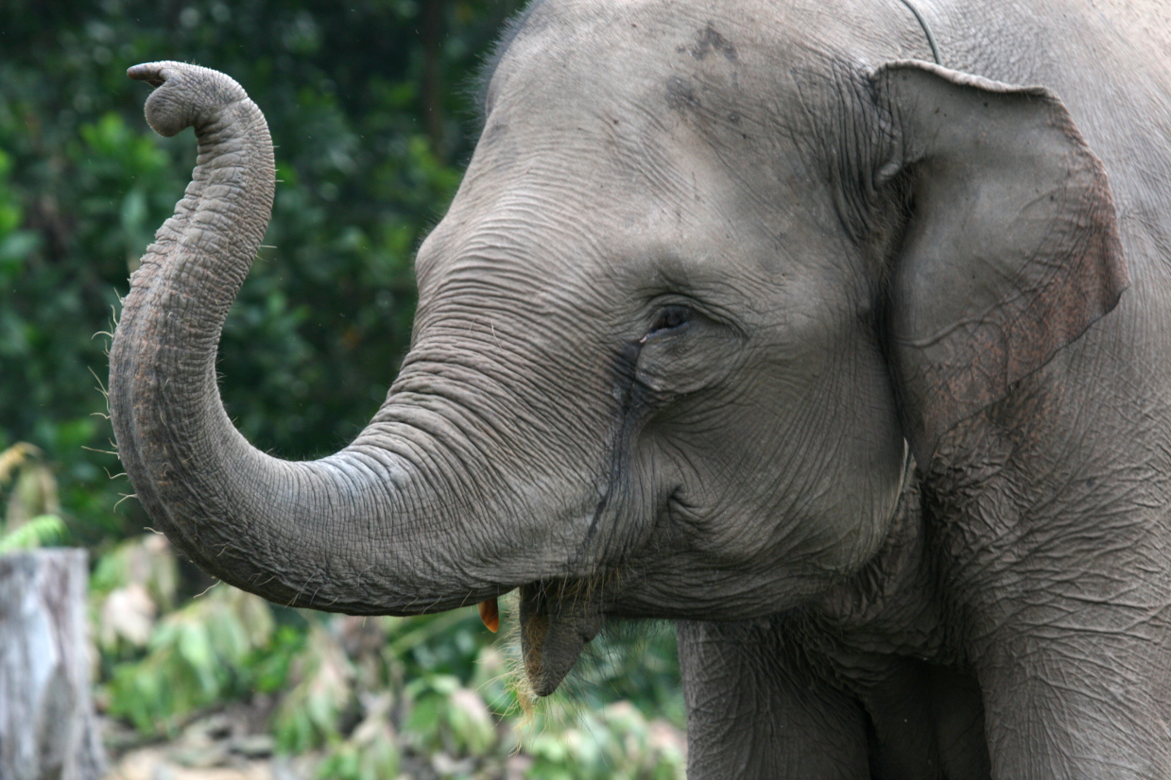
I like to see the bigs elephants
Ana Maria Gomez
Class; ESL 2
8/19/15

Slide 4
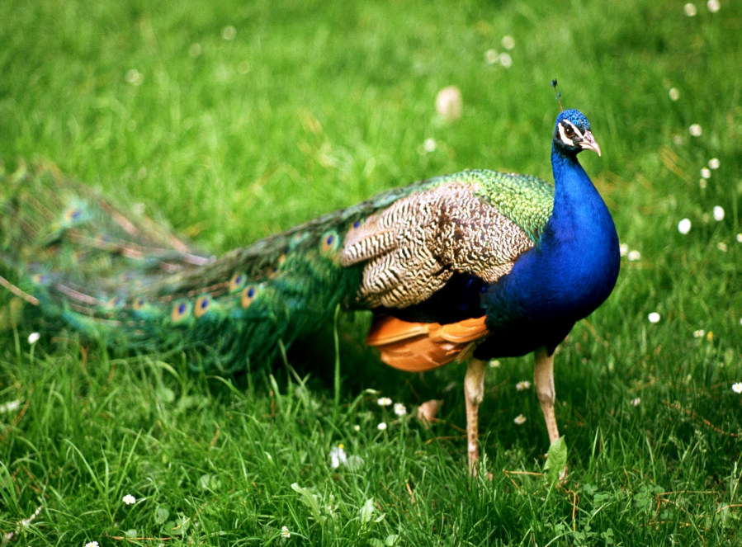
I like to see the family birds peacocks
Ana Maria Gomez
Class ;ESL 2
8/19/15

Slide 5
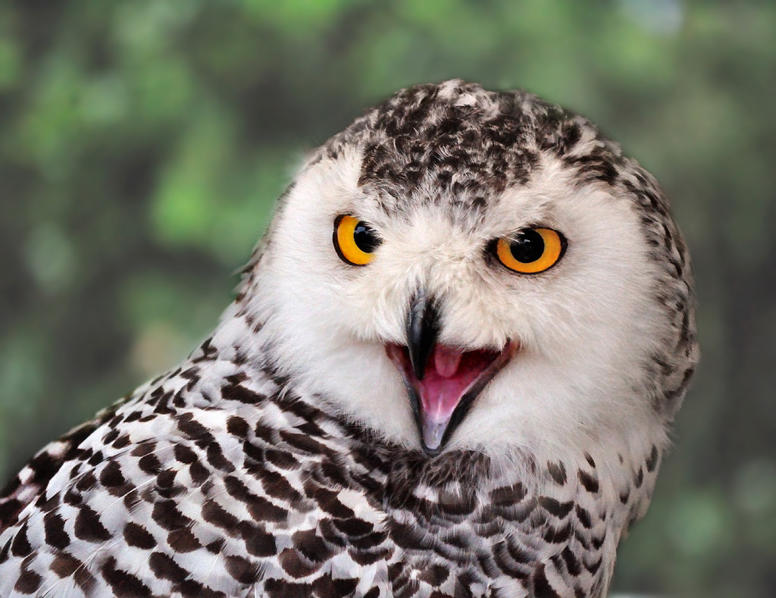
I LIKE TO SEE THE BEATIFUL OWL

Slide 6
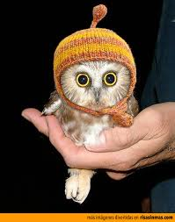
THANK YOU

