Slide 1
My favorite zoo animals
Jesus guerrero 08\19\2015

Slide 2
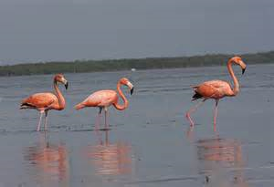
I like to see the beautiful flamingos

Slide 3
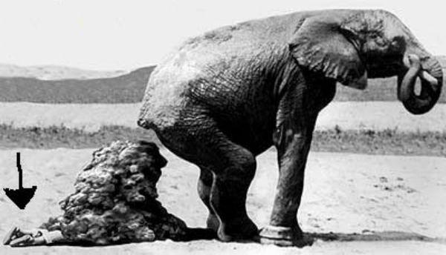
The elefant is cute

Slide 4
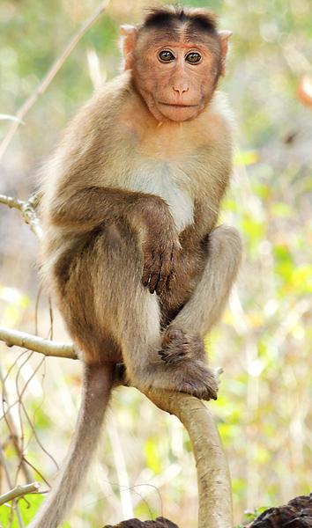

Slide 5
