Slide 1
How Much? How Many

Slide 2
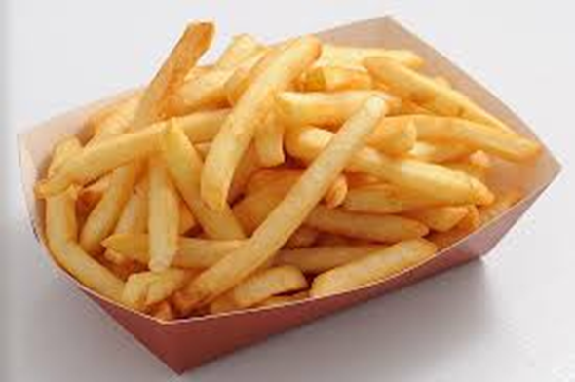
French Fries
How many?

Slide 3
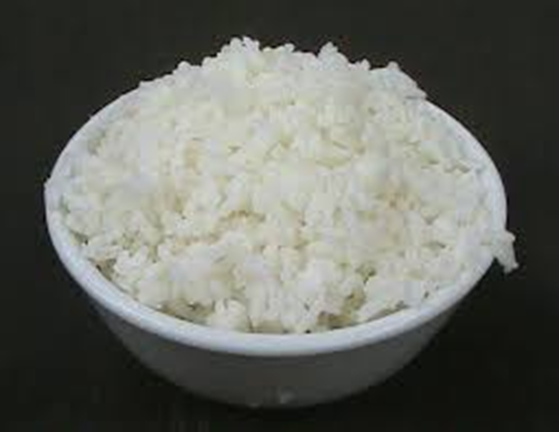
Rice
How much?

Slide 4
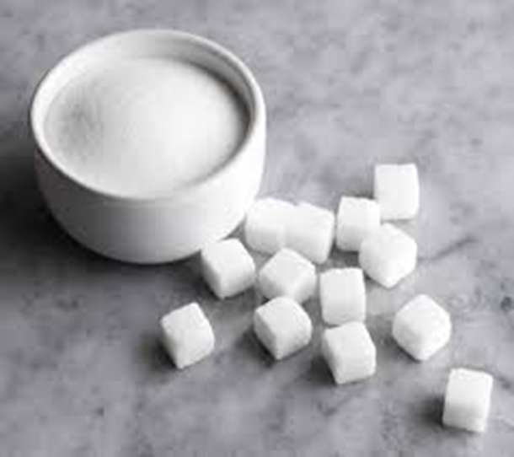
Sugar
How much?

Slide 5
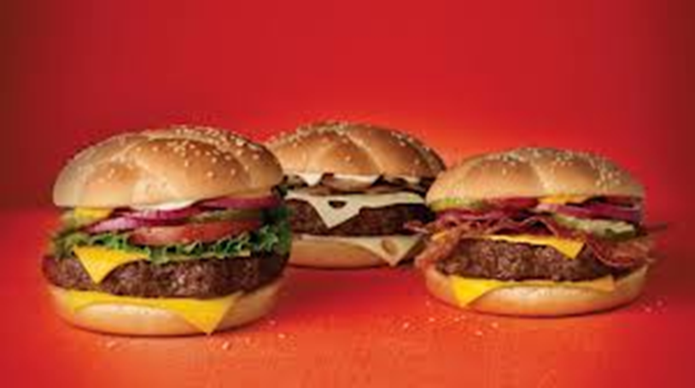
Hamburgers
How many?

Slide 6
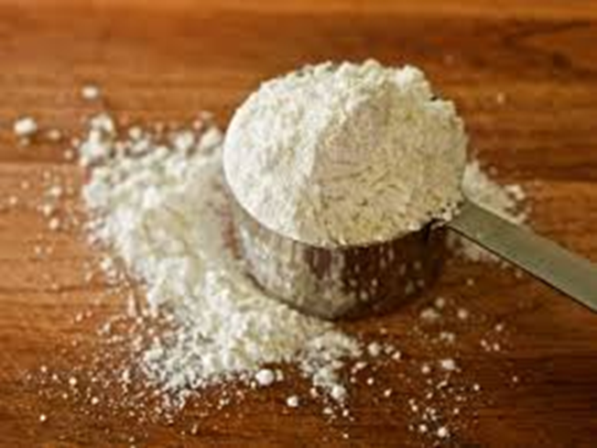
Flour
How much?

Slide 7
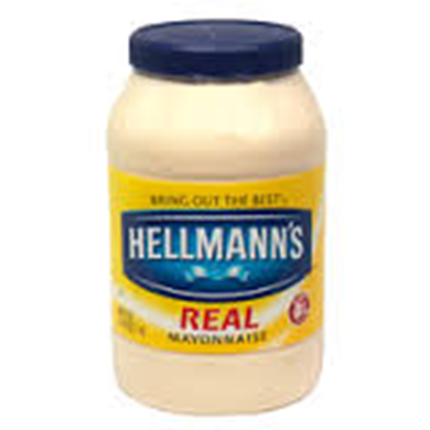
Mayonnaise
How much?

Slide 8
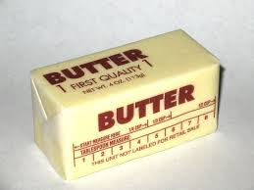
Butter
How much?

Slide 9
Orange juice
How much?

Slide 10
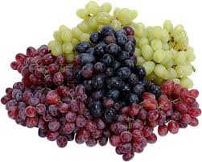
Grapes
How many?

Slide 11
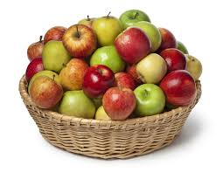
Apples
How many?

Slide 12
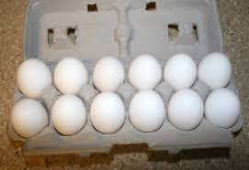
Eggs
How many?

Slide 13
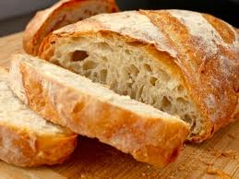
Bread
How much?

Slide 14
Mangos
How many?

Slide 15
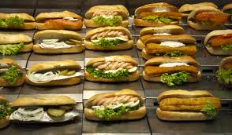
sandwiches
How many?

