Slide 1
Introduction to Partitives
Mrs. Alba
ESL 2

Slide 2
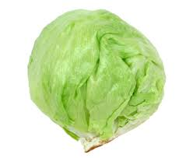
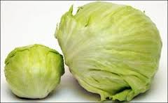
Introduction to Partitives
RULE: Non-count nouns cannot be counted, but they may be measured. Partitives measure specific quantities of non-count nouns. Partitives can be counted.
EXAMPLES:
a head of lettuce
two heads of lettuce

Slide 3
Introduction to Partitives
RULE: Partitives can measure by weight or size.
EXAMPLES:
A pound of cheese
A gallon of milk
A quart of orange juice
A pint of ice cream

Slide 4
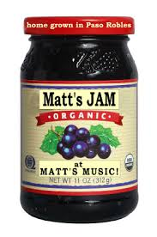
Introduction to Partitives
RULE: Partitives can measure by describing the container.
EXAMPLES:
A box of cereal
A jar of jam
A bottle of ketchup

Slide 5
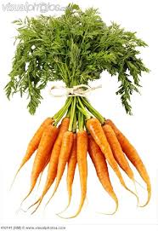
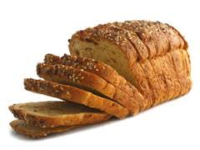
Introduction to Partitives
RULE: Partitives can measure by describing the shape
EXAMPLES:
A head of lettuce
A bunch of carrots
A loaf of bread

Slide 6
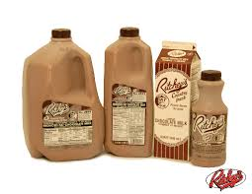
Introduction to Partitives
RULE: English measurements are different from the metric system.
EXAMPLES:
1 Pound= 0.45 kilograms
1 Pint= 0.475 liters
1 Quart (2 pints)= 0.95 liters
1 Gallon (4 quarts)= 3.8 liters

