Slide 1
Partitive Match Game

Slide 2
We need a can of…
A) cereal
B) beans
C) meat

Slide 3
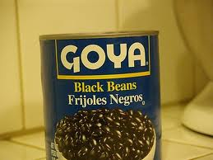
We need a can of…
B) beans

Slide 4
We need a pound of…
A) eggs
B) ketchup
C) meat

Slide 5
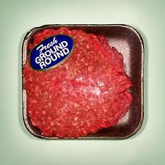
We need a pound of…
C) meat

Slide 6
We need a pint of…
A) ice cream
B) lettuce
C) eggs

Slide 7
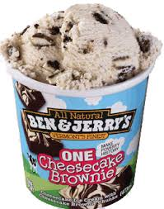
We need a pint of…
A) ice cream

