Slide 1
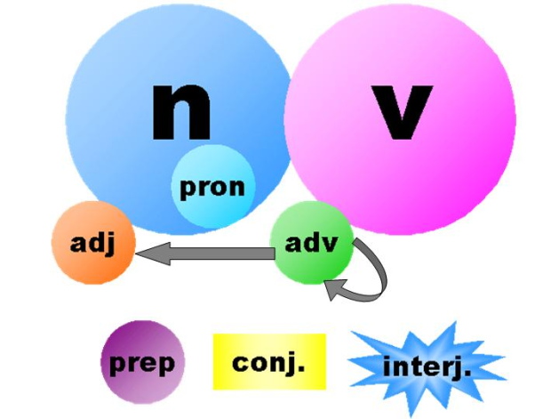
Parts of Speech
By: Prof. Diana Vera-Alba
ESL Level 2

Slide 2
What are the Parts of Speech? partes de la oración
Verbs* verbos
Nouns* sustantivo
Adjectives adjetivos
Adverbs adverbios
Pronouns pronombres
Prepositions preposiciones
Conjunctions conjunciones
Interjections interjecciones

Slide 3
Part of Speech: Verbs verbos
Function or "job" | Example words | Example sentences
Action (acción) or State of being (estado de ser) | (to) be (ser) have (tener) do (hacer) like (como) Work (trabajar) sing (cantar) can (puede) must (debe) | The woman is singing. I like her voice. She can really sing. She must be a professional singer.
http://www.schooltube.com/video/2f64b89f85db90e07260//

Slide 4
Part of Speech: Nouns sustantivo
Function or "job" | Example words | Example sentences
Person (persona), place (lugar) or thing (cosa) | Pen (lápiz), dog (perro), work (trabajo) , music (música), town (ciudad), London (Londres), teacher (maestro), John | This is my dog. He lives in myhouse. We live in London.
http://www.schooltube.com/video/21001073474c19344891/

Slide 5
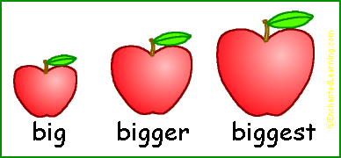
Part of Speech: Adjectives adjetivos
Function or "job" | Example words | Example sentences
describes a noun | a/an, the, 2, some, good, big, red, well, interesting | I have two dogs. My dogs are big. I like big dogs.

Slide 6
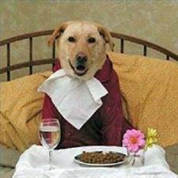
Part of Speech: Adverbs adverbios
Function or "job" | Example words | Example sentences
describes a verb, adjective or adverb | quickly, silently, well, badly, very, really | My dog eats quickly. When he is very hungry, he eats really quickly.

Slide 7
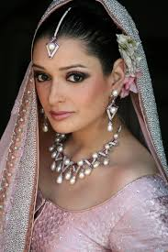
Part of Speech: Pronouns pronombres
Function or "job" | Example words | Example sentences
replaces a noun | I, you, he, she, some | Tara is Indian. She is beautiful.
She

Slide 8
Part of Speech: Prepositions preposiciones
Function or "job" | Example words | Example sentences
links a noun to another word | to, at, after, on, but | We went to school on Monday.

Slide 9
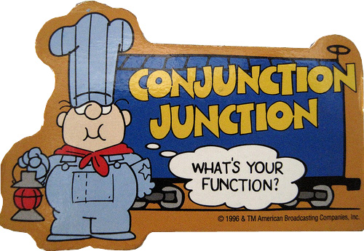
Part of Speech: Conjunctions conjunciones
Function or "job" | Example words | Example sentences
joins clauses or sentences or words | and, but, when | I like dogs and I like cats. I like cats and dogs. I like dogs but I don't like cats.
http://www.schooltube.com/video/9d37200dbcb55fe20cfc/

Slide 10
Part of Speech: Interjections interjecciones
Function or "job" | Example words | Example sentences
short exclamation, sometimes inserted into a sentence | oh!, ouch!, hi!, well | Ouch! That hurts! Hi! How are you? Well, I don't know.
http://www.schooltube.com/video/5eb2d59975159f0343b7/

Slide 11
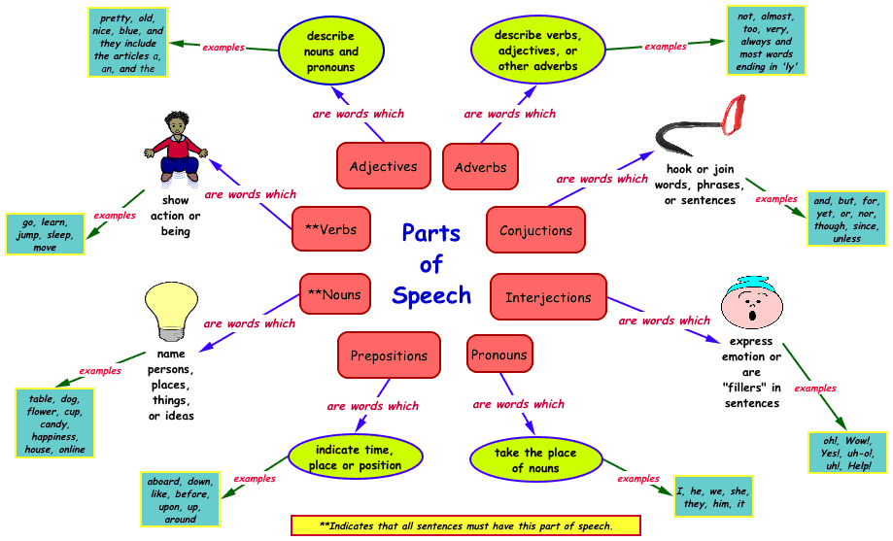
Parts of Speech Diagram

