Slide 1
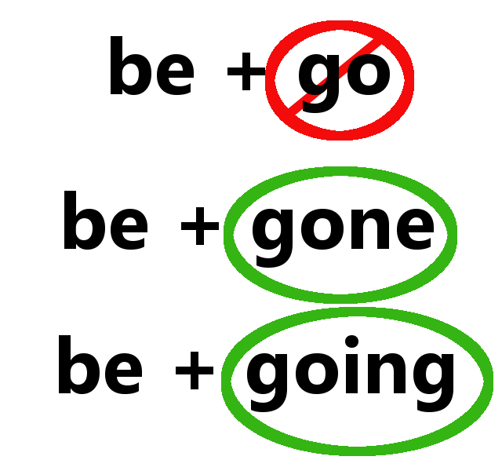
Present continuous passive
Mrs. Alba, esl 4

Slide 2
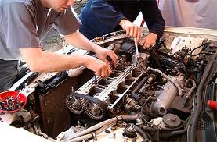
Present continuous- passive
RULE: The present continuous of the passive voice is formed with the verb “TO BE” in the present continuous the past participle of the verb.
EXAMPLES:
It is being repaired.
They are being taken in.
PLUS

Slide 3
Questions?

