Slide 1
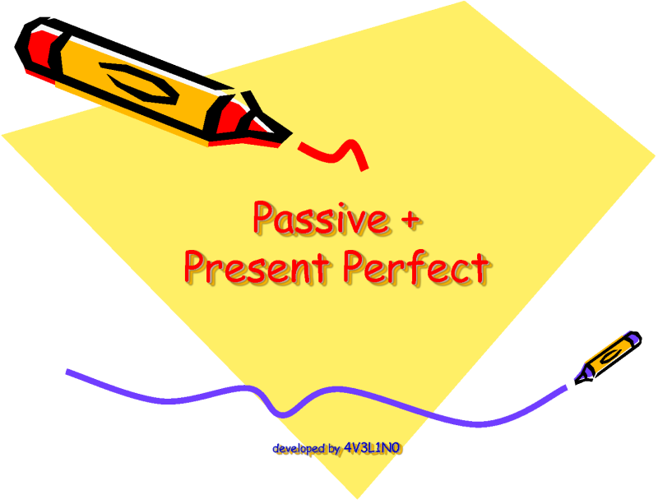
PRESENT PERFECT PASSIVE
ESL Level 4
Mrs. Alba

Slide 2
pRESeNT PERFECT PASSIVE
RULE: The passive voice is used when the doer of the action is unknown or when the doer is unimportant.
EXAMPLES:
The report has already been written. {we don’t know who wrote the report. We only know that the report is written}
The decorations have already been hung up. {we don’t know who hung up the decorations. We only know that the decorations are up}

Slide 3
Present perfect passive
RULE: The present perfect of the passive voice is formed with: the verb “to be” in the present perfect the part participle.
Examples:
It’s already been written.
They’ve already been hung up.
Plus

Slide 4
Questions?

