Slide 1
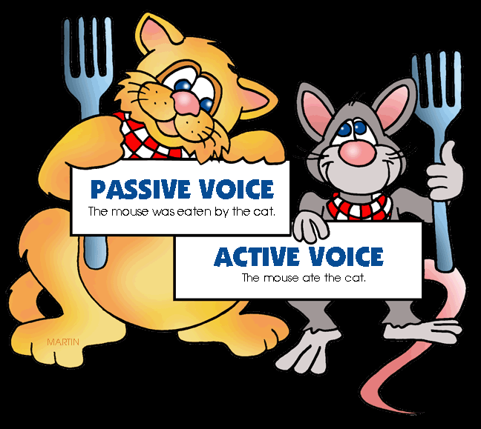
The Passive Voice
ESL Level 4
Mrs. Alba

Slide 2
The Passive Voice
RULE: The passive voice is used to express information in an impersonal or objective way.
EXAMPLES:
The airplane was flown by the Wright brothers.
The sonata was composed by Mozart.
Notes:
Instead of “The Wright brothers flew the airplane”

Slide 3
The Passive Voice
RULE: Many verbs in English can be used in both the active and the passive voice. In the passive sentences, the receiver of the action becomes the subject of the verb. The “doer” of the action is indicated by the expression by __________.
EXAMPLES:
Active: Edgar Allan Poe wrote the story.
Passive: The story was written by Edgar Allan Poe.
Active: Napoleon wore the uniform.
Passive: The uniform was worn by Napoleon.

Slide 4
The Passive Voice
RULE: The passive voice is formed with the verb to be and the PAST PARTICIPLE of the verb. Below are examples of the simple past form of the passive voice.
EXAMPLES:
It was written by Edgar Allan Poe.
It was worn by Napoleon.

Slide 5
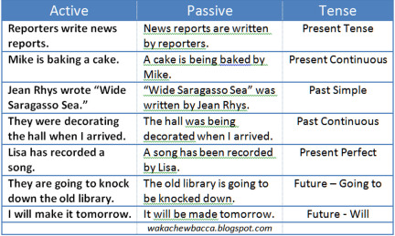
Comparison of Active vs. Passive Voice

