Slide 1
Present Real Conditional
Mrs. Alba
ESL 4

Slide 2
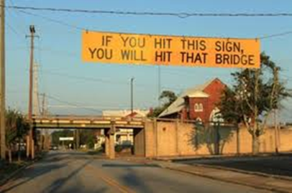
Present Real Conditional
The present real conditional is used to predict what will happen under certain (real) conditions. This form uses the present form of the verb in the if-clause, and the simple future in the result clause. Even though the if-clause refers to a future condition, it is in the simple present form of the verb.

Slide 3
EXAMPLES using the Present Real Conditional
IF…..
RESULT…
If the weather is good
If it rains,
she’ll probably ride her bicycle.
he’ll probably watch TV.
Note: the contractions she’ll & he’ll mean SHE WILL and HE WILL.

Slide 4
Questions?

