Slide 1
Present Unreal Conditional
Mrs. Alba
ESL 4

Slide 2
Present Unreal Conditional
RULE: The present Unreal conditional is used to talk about what would happen in the present under unreal conditions.
The simple past form is used in the if-clause, and would + a verb is used in the result clause.
If (past tense verb) , would + verb .

Slide 3
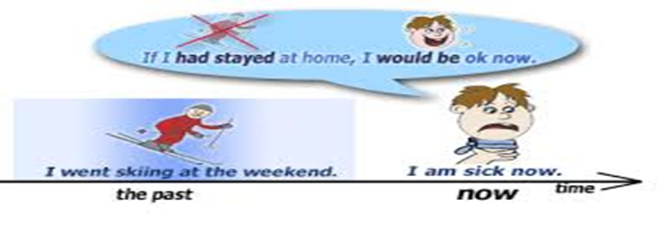
EXAMPLES using the Present Unreal Conditional
IF…..
RESULT…
If they lived closer,
If he studied more,
They would visit more often.
He would get good grades.

Slide 4
Present Unreal Conditional
RULE: In the present unreal conditional, were is used as the simple past form of be for both singular and plural subjects.
EXAMPLES:
If she were more outgoing, she’d have friends at school.
If he were more aggressive, he’d be a good salesman.

Slide 5
Questions?

