Slide 1
Wishes about the PRESENT, PAST & Present Real Conditional
Mrs. Alba
ESL 4
Unit 7

Slide 2
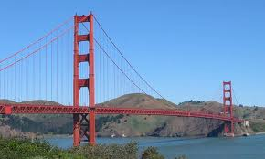
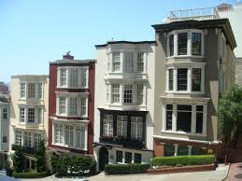
Form: Wishes about the Present
_________ wish (past tense) .
wishes
I wish I lived in San Francisco.
.

Slide 3
Form: Wishes about the Past
_________ wish (past perfect tense) .
wishes FORM [had + past participle]
John wishes he had bought a new car.

Slide 4
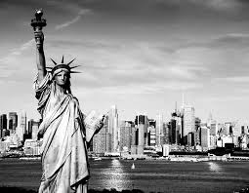
Form: Wishes about the Past
RULE: The verb wish + the past perfect tense is used to express a desire for something that was not possible in the past.
EXAMPLES:
I didn’t live in New York. I wish I had lived in New York.
I didn’t drive to work today. I wish I had driven to work today.

Slide 5
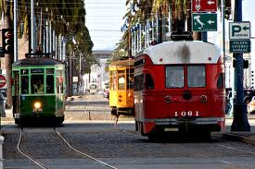
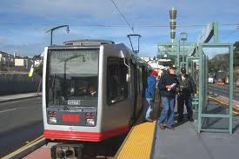
Form: Present Real Conditional Review
If (past tense) , wouldn’t.
If I lived in San Francisco, I wouldn’t need a car.

Slide 6
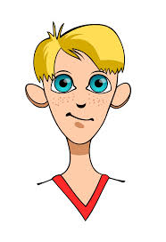
Wishes about the past
Mark
Mark took the
Bus. He wishes
he had taken the train.
Jane
Jane went to the 7 o’clock movie. She wishes she had gone to the 9 o’clock movie.
My cousins
My cousins arrived early. They wish they had arrived later.

