Slide 1
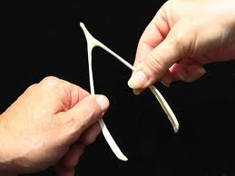
Wish clauses
Mrs. Alba ESL 4

Slide 2
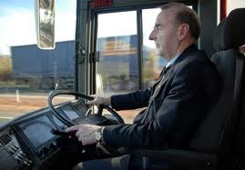
Wish-clause
RULE: The verb wish + the simple past tense is used to talk about a desire for something that is not possible under real conditions.
EXAMPLES: I wish I drove a school bus.
She wishes she lived in the city.

Slide 3
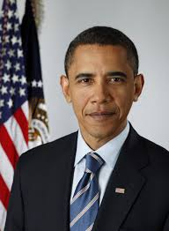
Wish-clause
RULE: When a form of the verb to be follows a wish-clause, were is used with all pronouns, just as with the conditional.
EXAMPLES: He wishes he were an actor.
I wish I were the president.

